Slide 1


FinTech @ IU Python Session #1 – Getting Started
Prepared by
Gabriel Shores
Director of Technology – FinTech @ IU
https://www.linkedin.com/in/gabriel-shores-379b81291/
Cameron Nelson
VP Chief Investment Officer– FinTech @ IU
https://www.linkedin.com/in/cameron-j-nelson/
02/11/2025

Slide 2
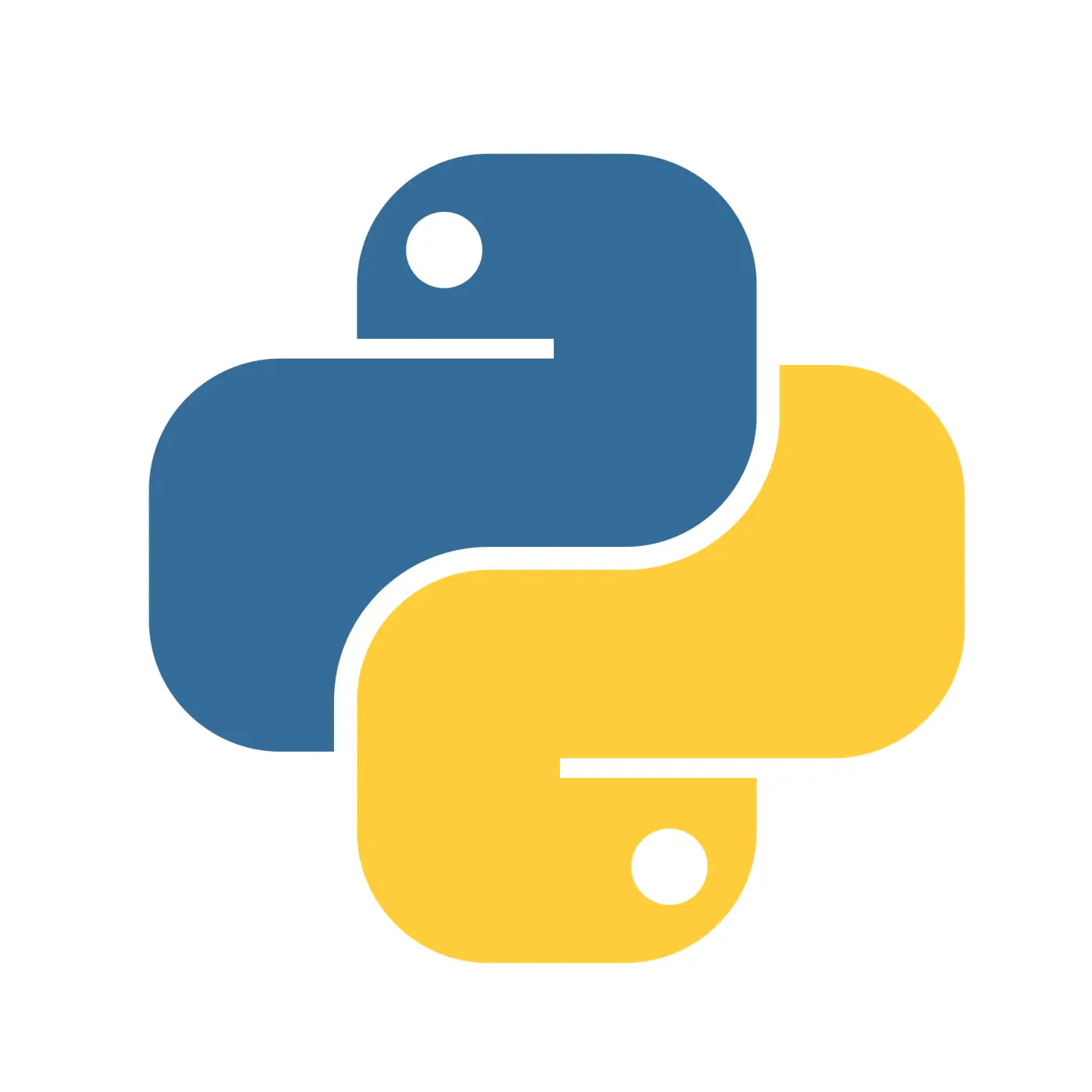
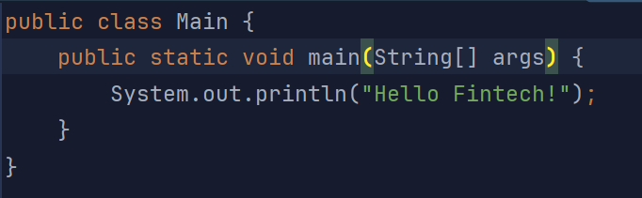
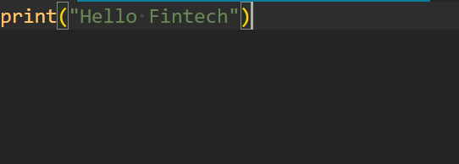
Why Learn Python & Coding
Most widely used programming language, allowing you to interface directly with your computer
Knowing how to code empowers you to automate tasks, and to better understand AI, allowing you to get more out of it
Easy and concise syntax makes it useful for data analysis
Integrated into Excel
Gives you the edge up on students
Printing “Hello Fintech” in Java (left) vs Python (right)

Slide 3
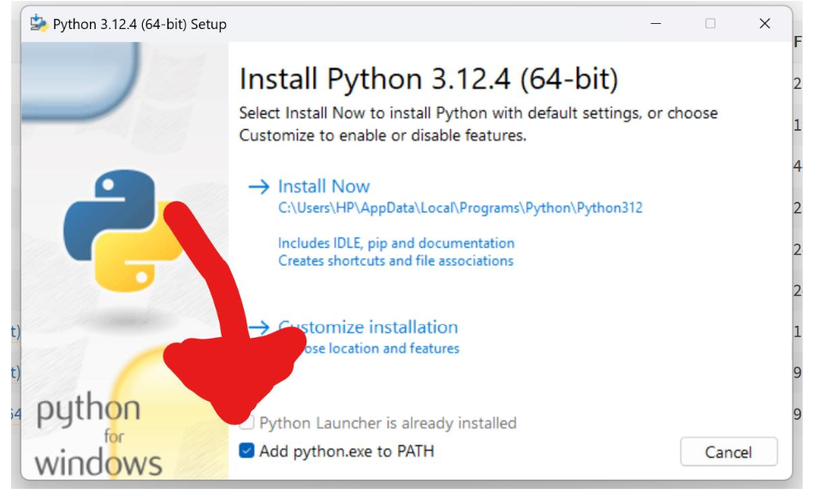
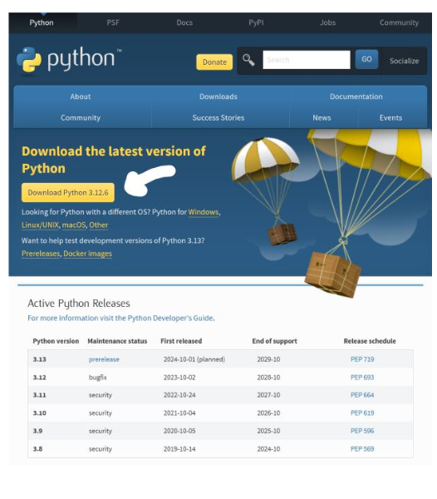
Python Installation
• Navigate to https://www.python.org/downloads/
Download the latest version of
Python, andmost then open the installer.
Go with default options, BUT →
Make sure to check to add
Python to PATH !!

Slide 4

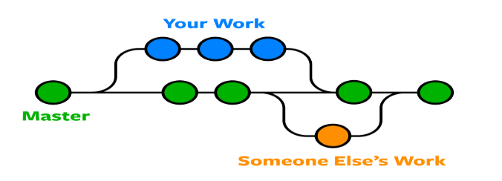
Why Install and Use GIT
Go-to version control system
Allows multiple people to work on one project separately
People can “pull” updated versions of the code to their machine and “push” and “commit” changes they have made
Kind of like a well-managed shared Google Doc

Slide 5
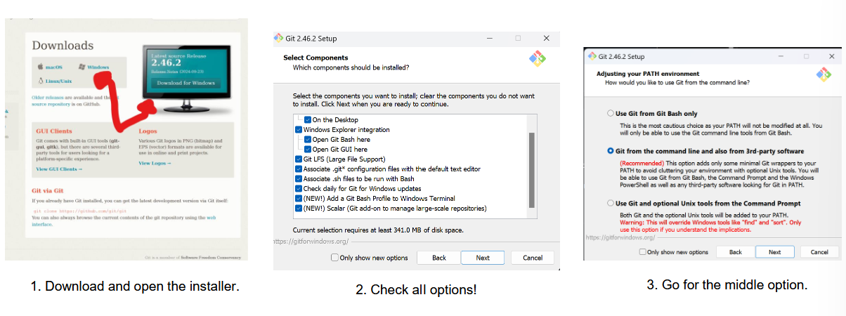
Install Git
Navigate to https://git-scm.com/downloads

Slide 6
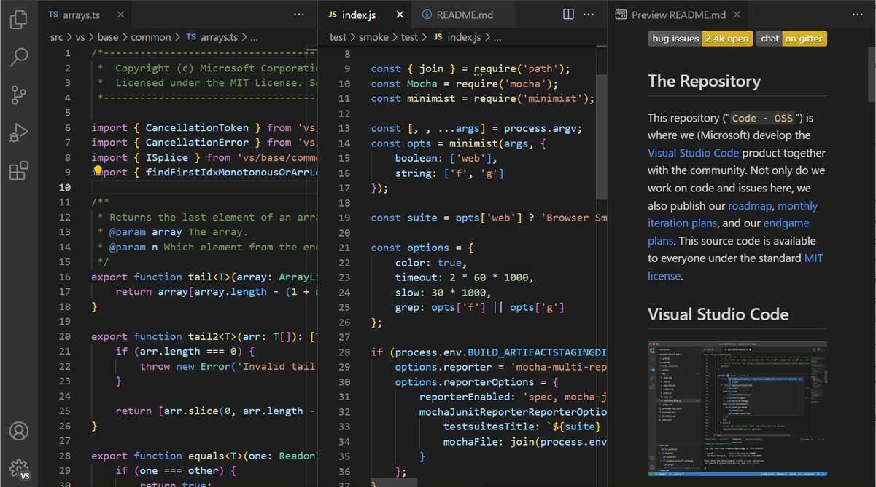

Why Install and Use VS Code
Allows the user to access, change, and run code
One of the most widely used code editor with plenty of extensions
This is where we will be coding

Slide 7
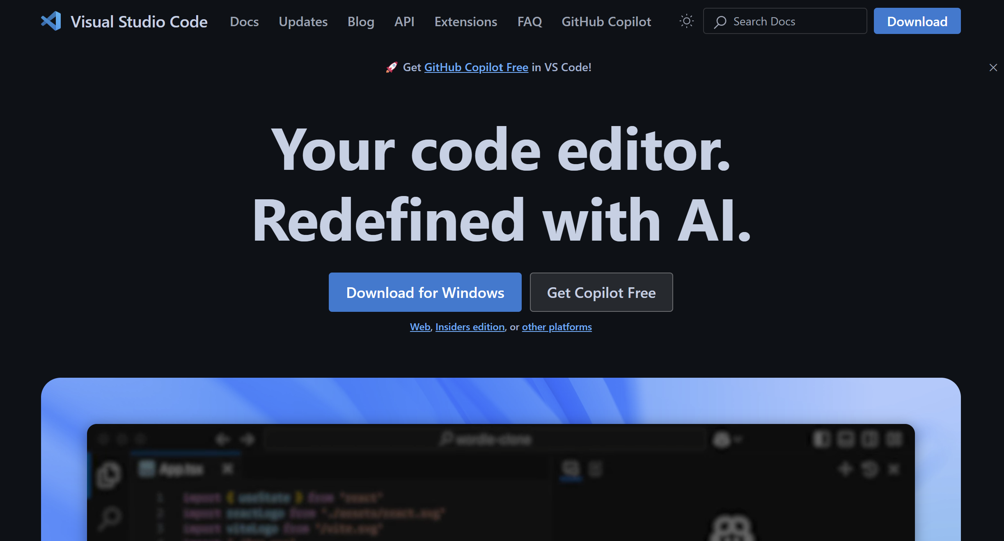
Installing VS Code
Navigate to https://code.visualstudio.com/
Follow setup in the .exe with default configs

Slide 8
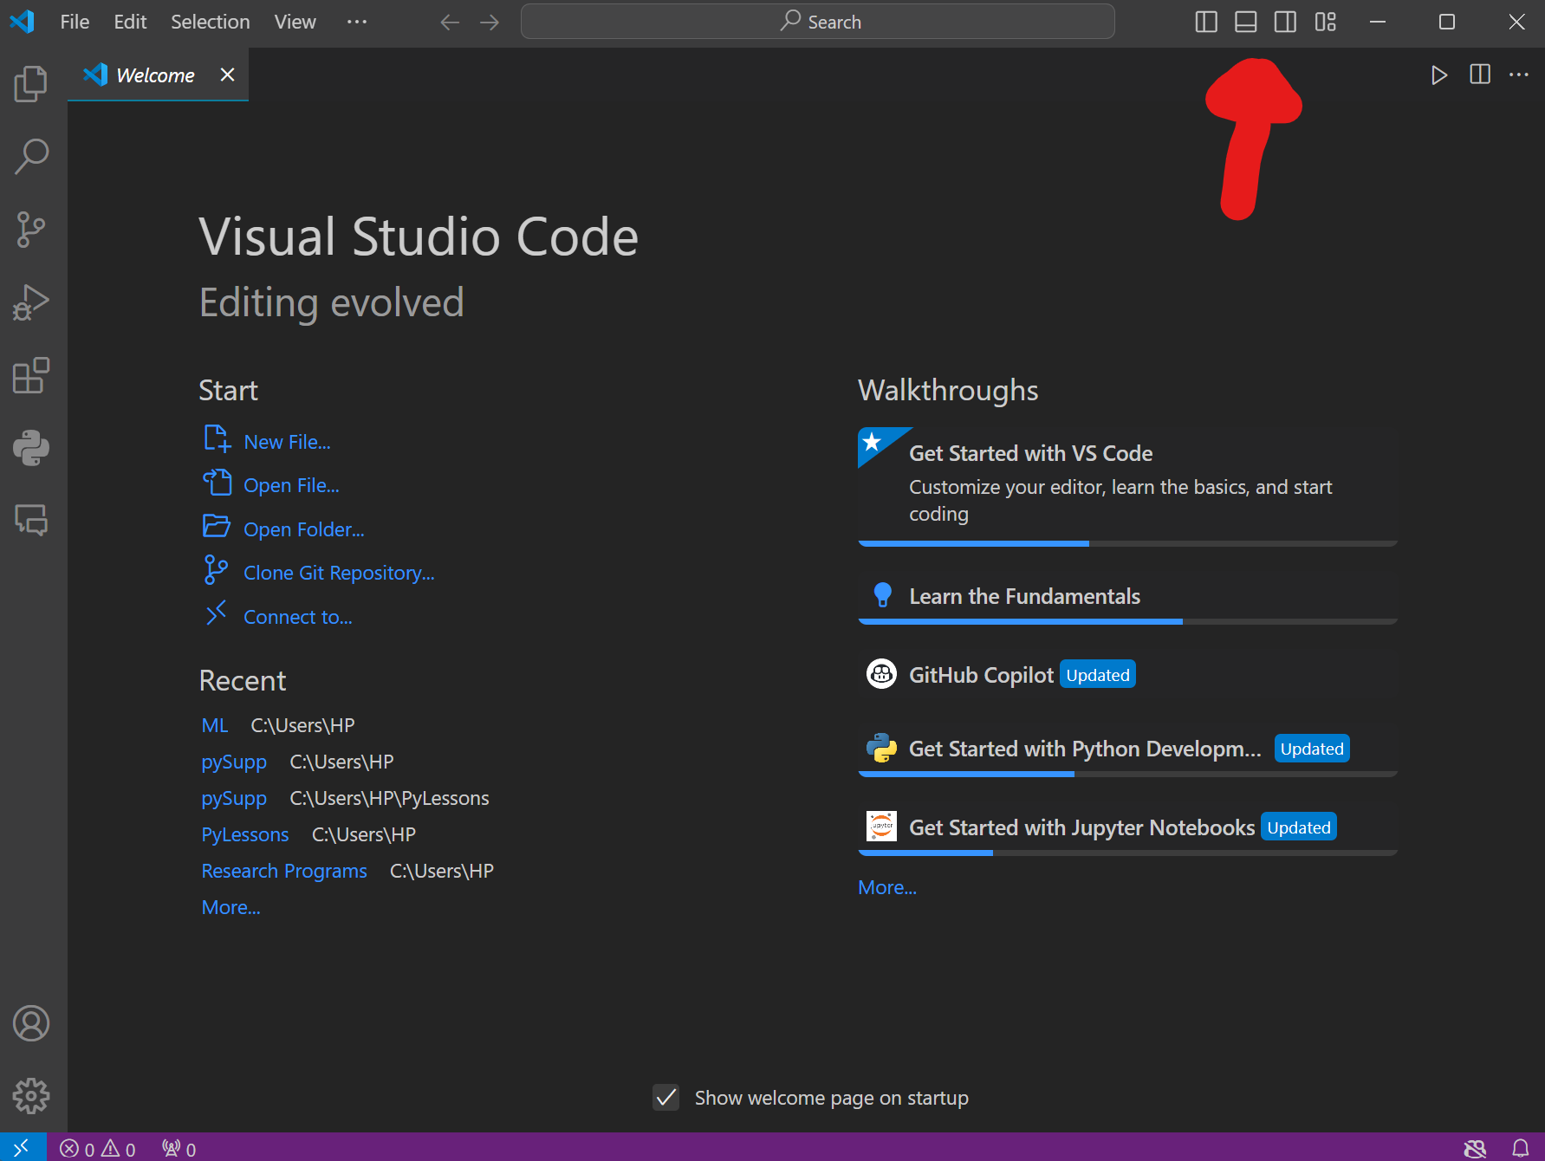
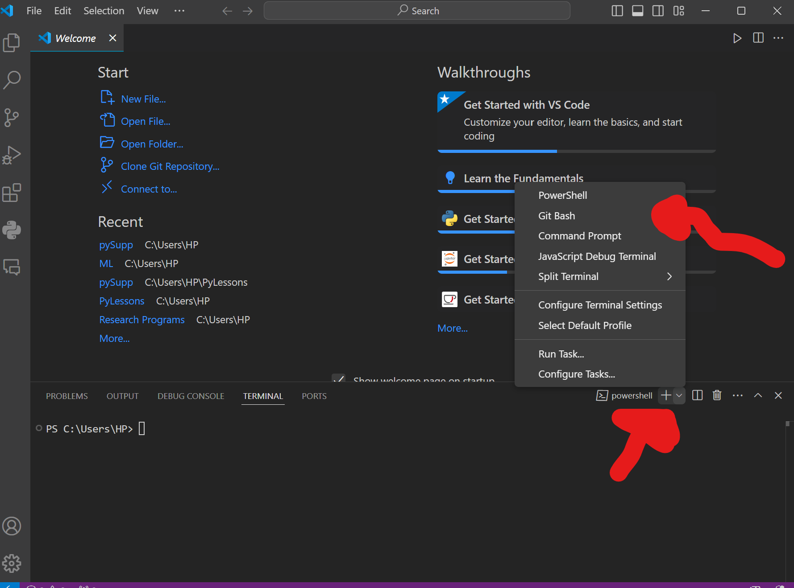
Setting Up Our First Project
Open VS Code!
1. Navigate to the top right and click on the second from the left option to open the terminal.
2. Click on the dropdown by “powershell” and click on “Git Bash in the options.

Slide 9
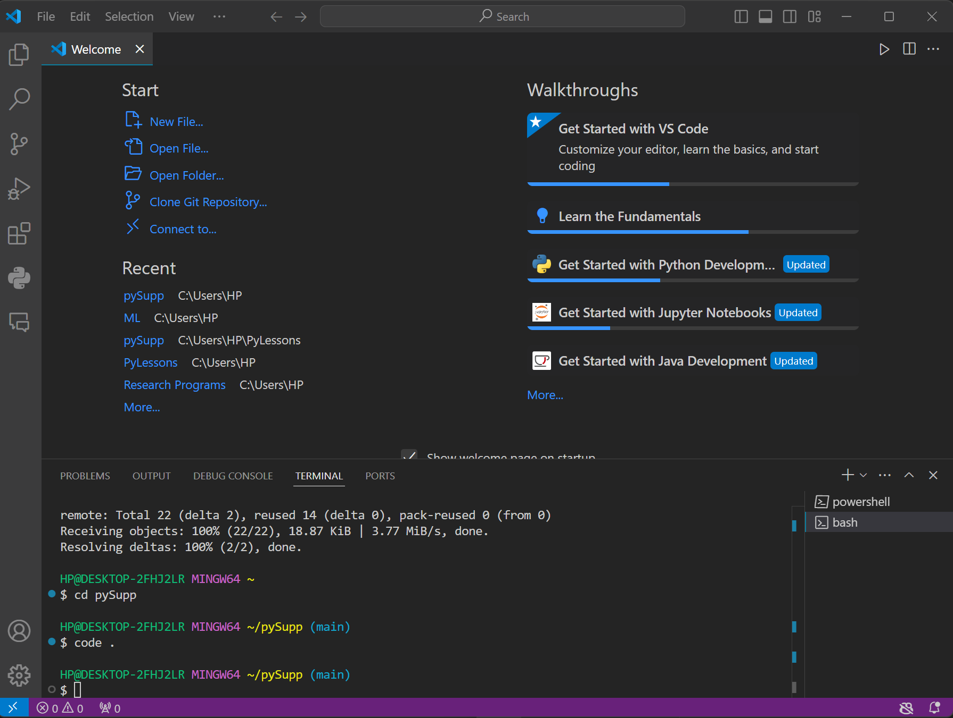
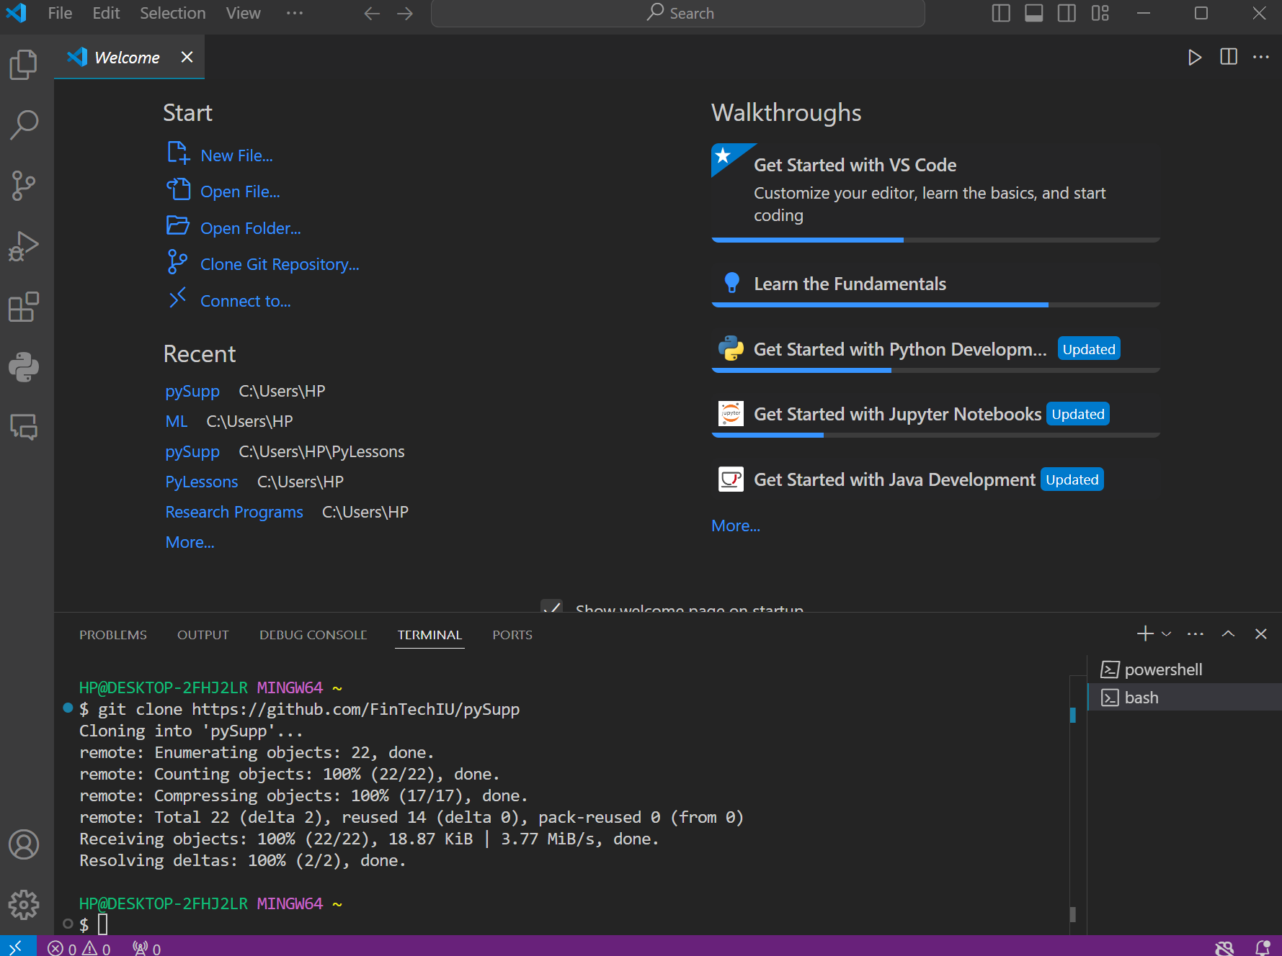
Setting Up Our First Project Cont.
This is the difficult part, don’t worry!
4. Type “cd pySupp“, enter, and then “code .” , enter to open the file. Alternatively navigate via open folder under start. It should be under Users/YourName/PySupp. Either way works.
3. Type in “git clone https://github.com/FinTechIU/pySupp” by the $ and press enter.

Slide 10
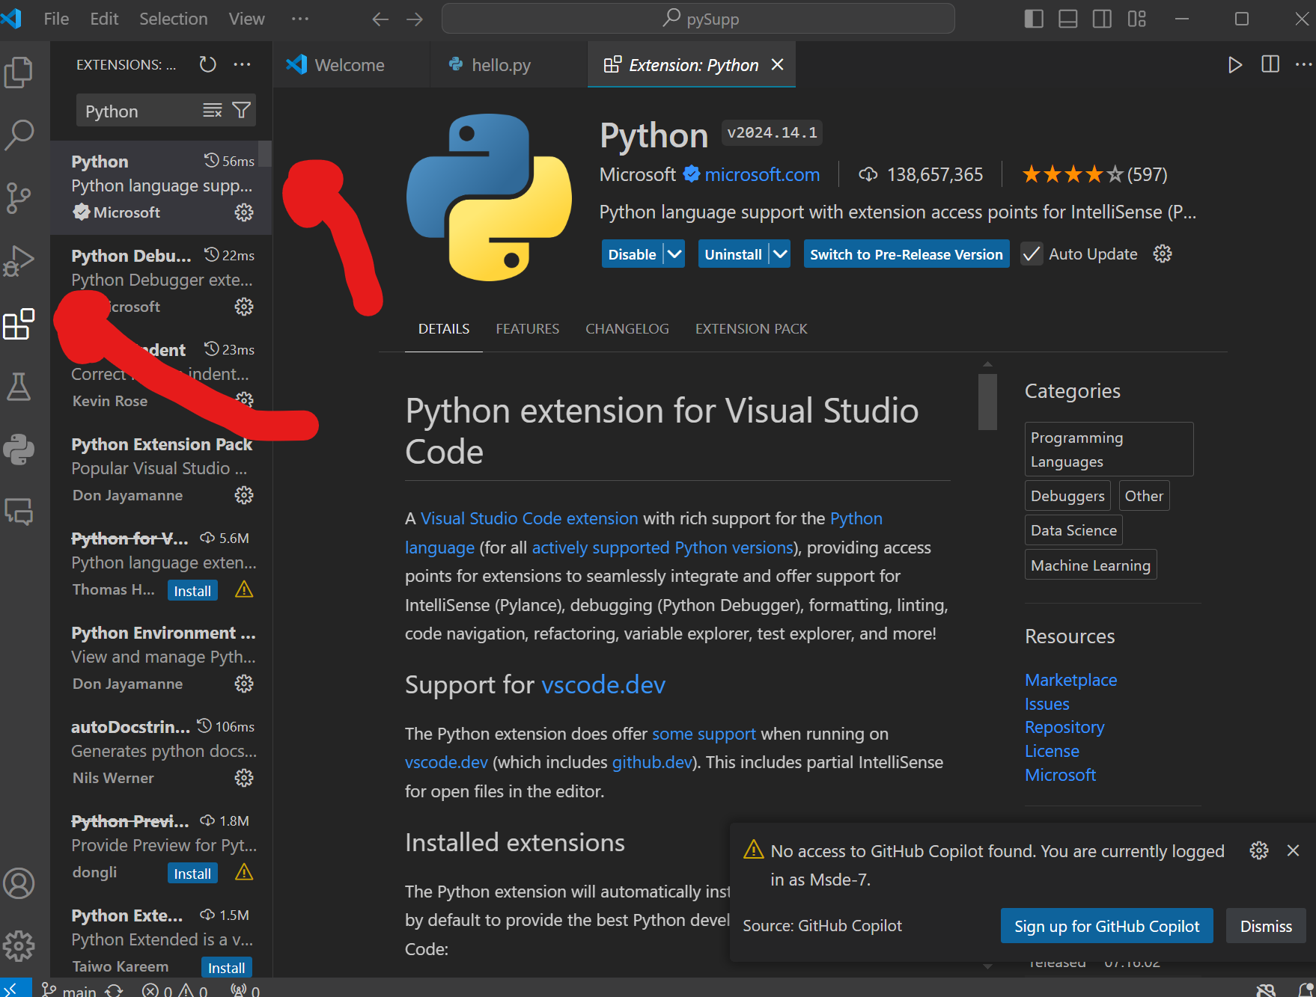
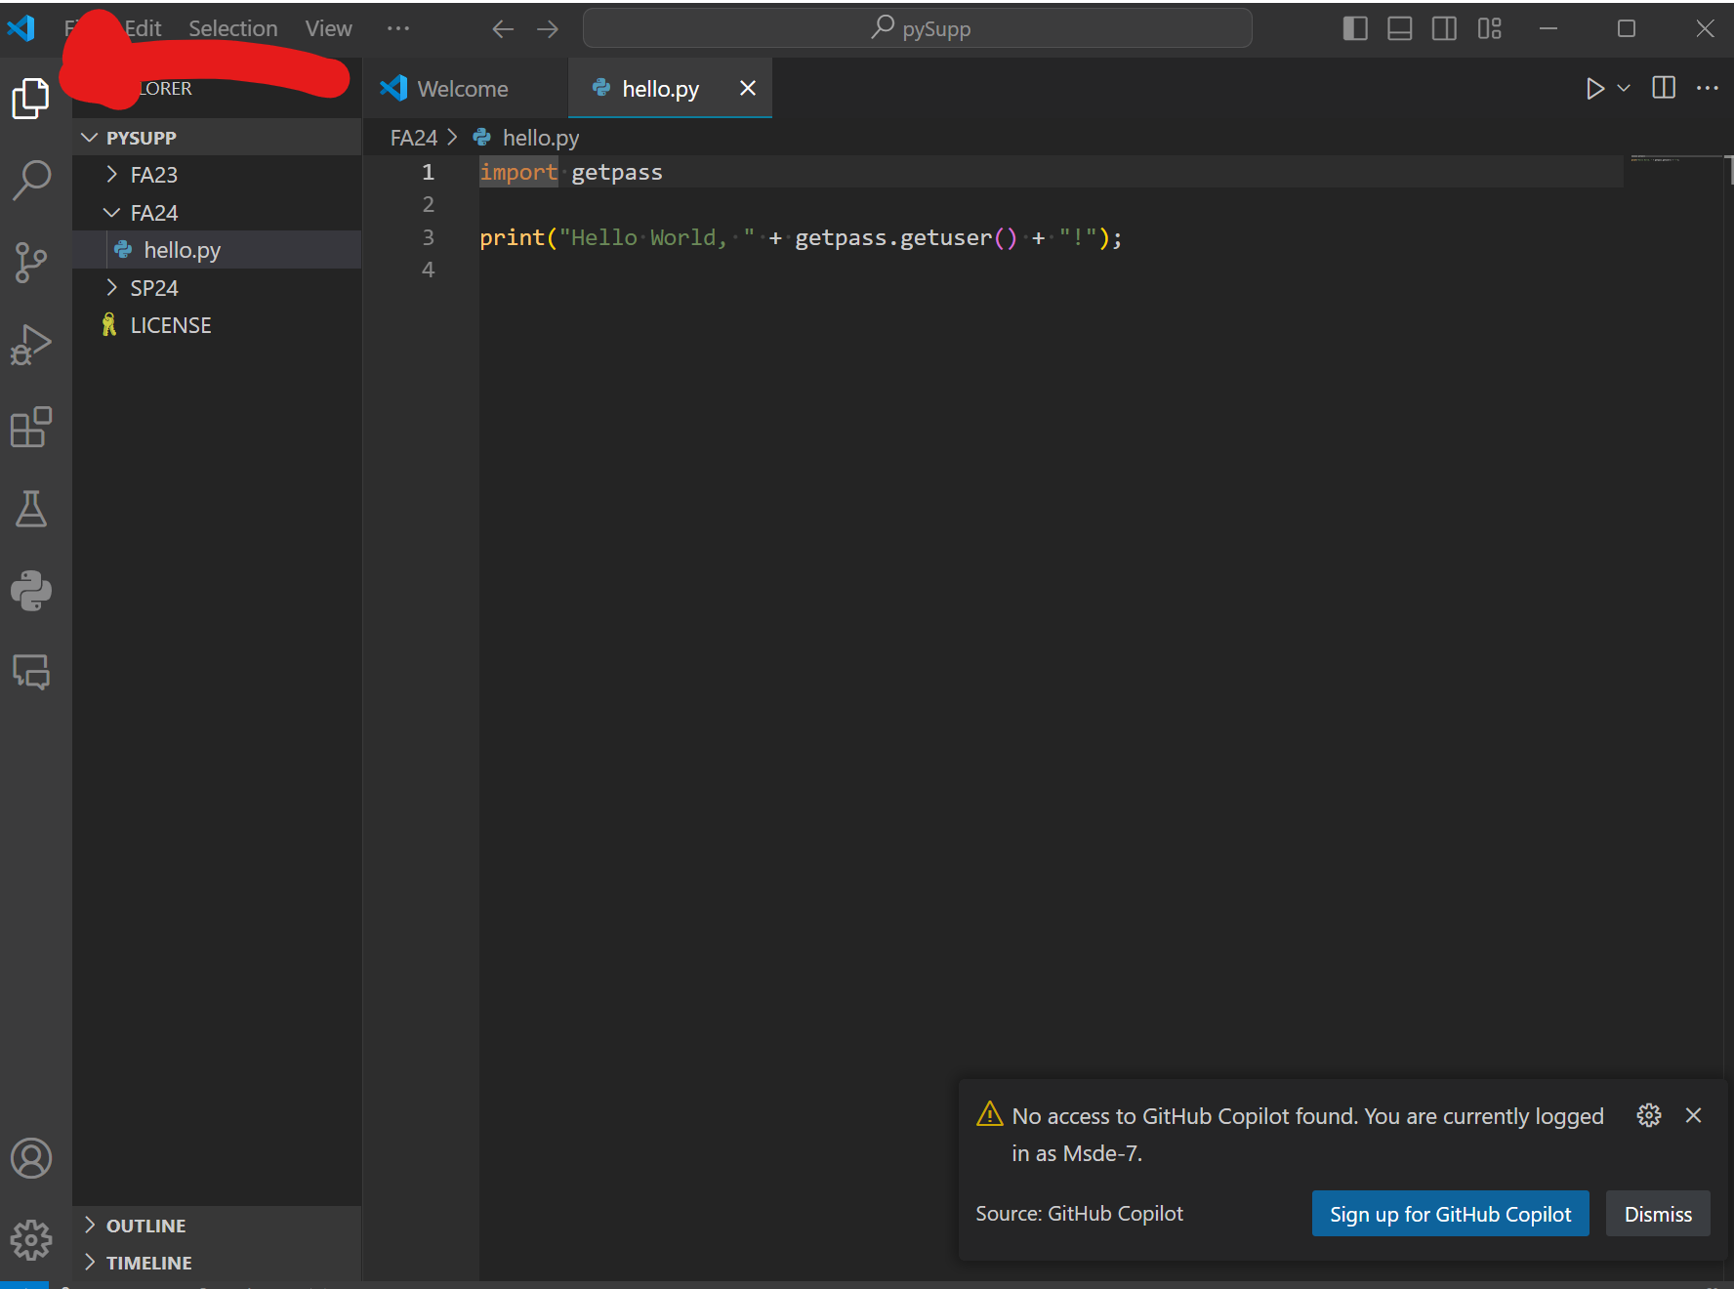
Open and Run Project
If an option to install the Python extension appears, do so.
If not click on the boxes on the side, type in Python, and install the first one.
Do the last step to get back.
Click on the top left explorer button, and then in the dropdown.
Go to SP25 -> hello.py

Slide 11
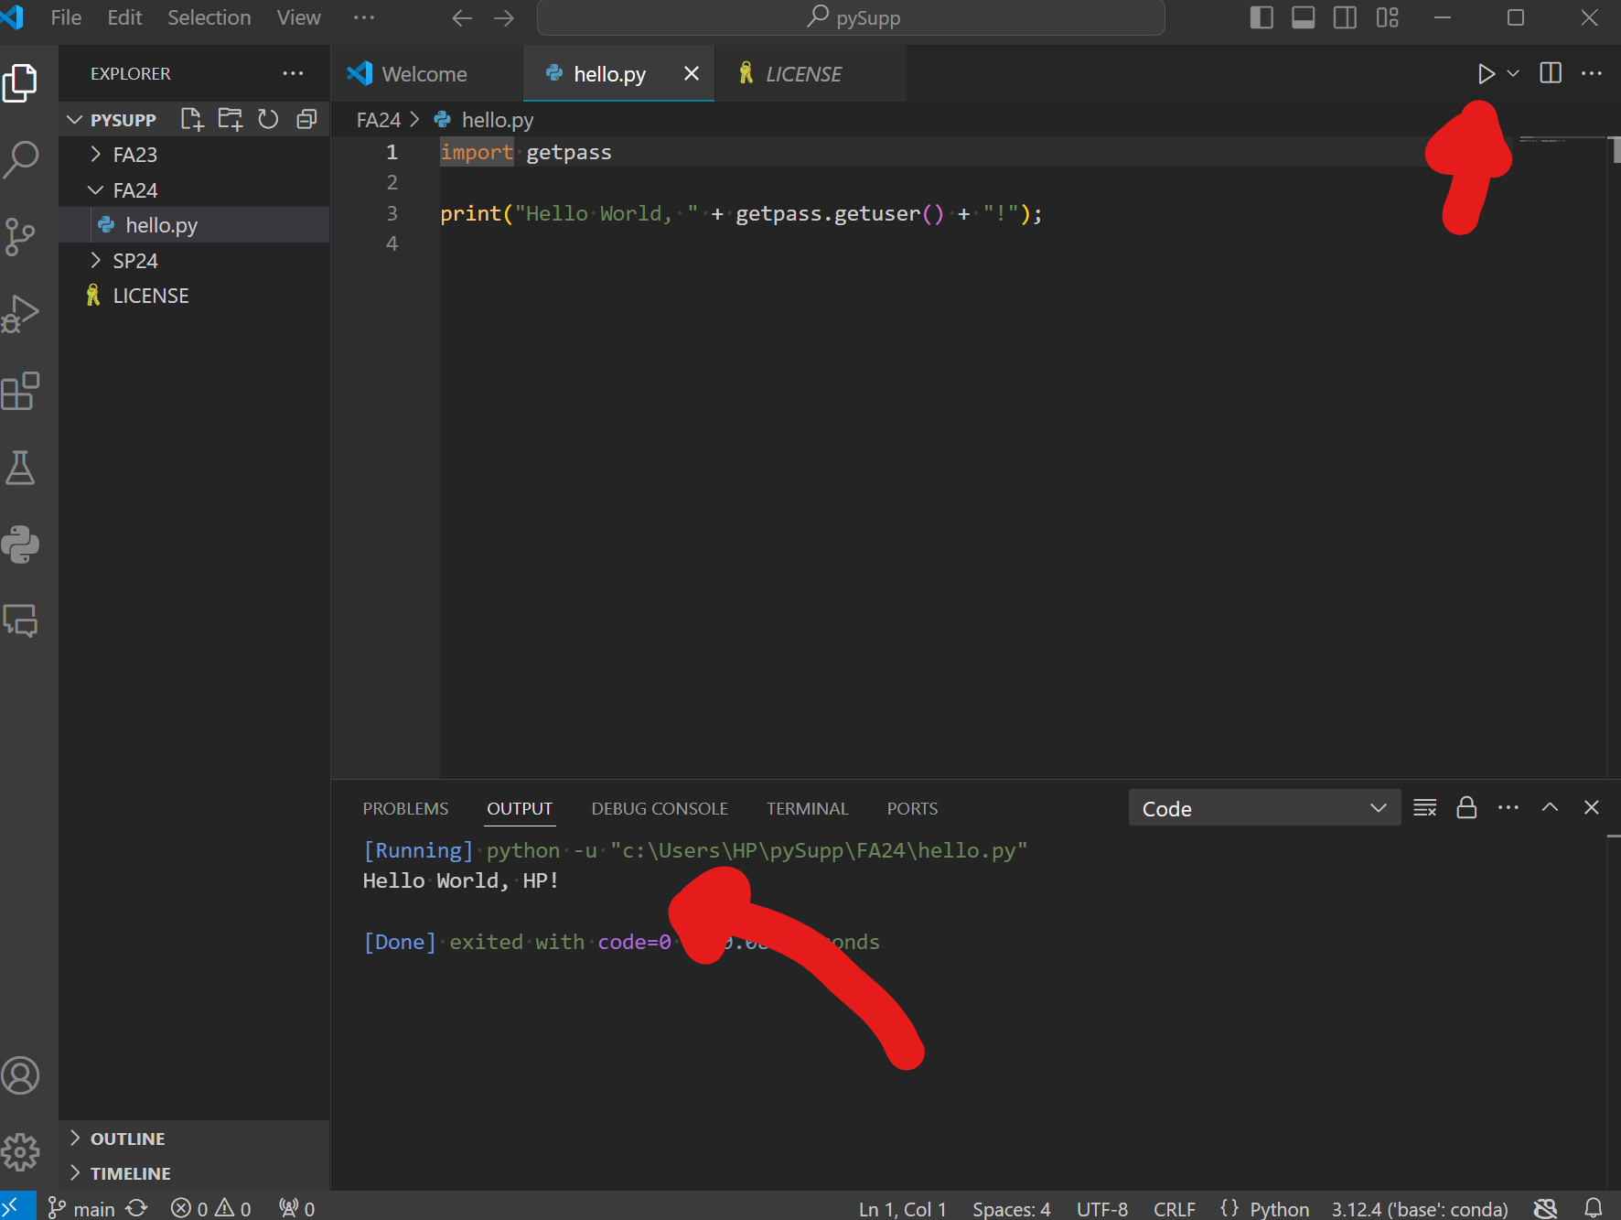
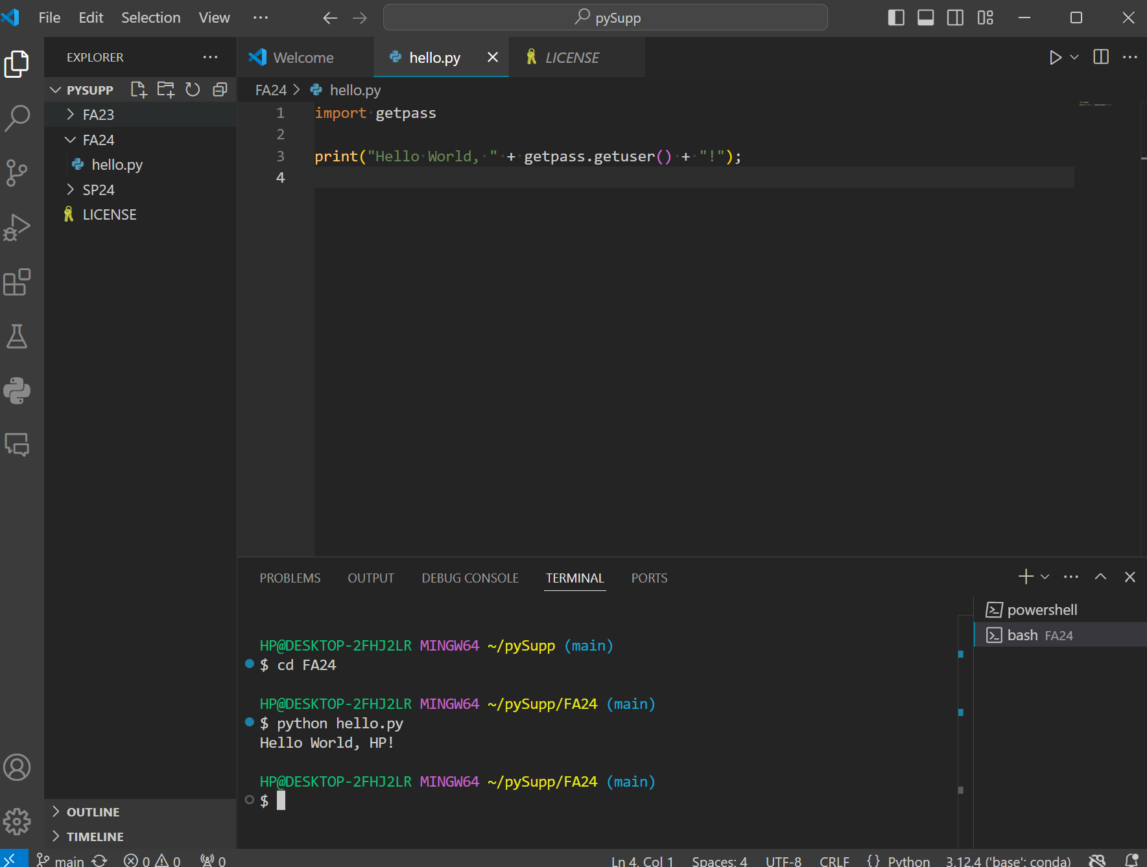
Open and Run Project
Alternatively, navigate to the terminal (click on the name in the bottom window or click on the top right button to open up the window), click the dropdown by powershell/ the + button, and click git bash.
Type cd SP25 to open the SP25 folder and then python hello.py to run our file.
Click the run button in the upper right, and an output saying “Hello world, <Your Username>! should appear.

Slide 12
The End!
Don’t be discouraged if anything was confusing or you had any problems
Setup is often the lengthiest day in the first few coding classes, and we still encounter issues
Next lesson will dive into Python basics so that we can later start to see some applications to finance
If you have any questions message the GroupMe or Gabe Shores and/or Cameron Nelson
Thank you!

